Slide 1



OSHA 10/30 - Hour Refresher Training

Slide 2
Electrical
  The U.S. Bureau of Labor Statistics (BLS) shows electrocution was the fourth leading cause of death in construction
  *Center for Construction Research & Training
Notes:
video

Slide 3
The First Rule To Live By: Never Second Guess Electrical Hazards! If you are ever in doubt about a course of action,
STOP!
Consult a Supervisor and/or Safety Professional
Notes:
4
4
4
4
4
When working on electrical equipment and components never make assumption. Always ensure through approved methods the absence of electrical current

Slide 4
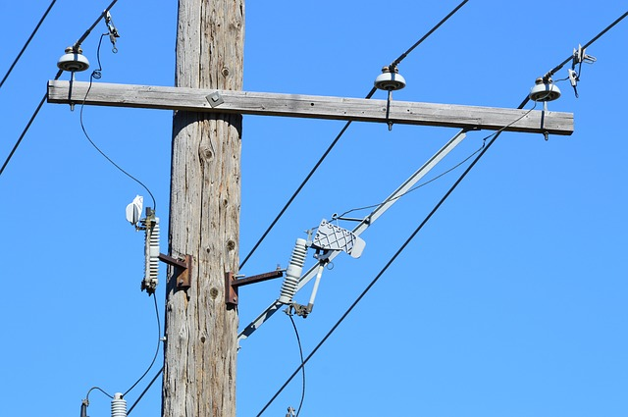

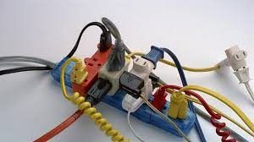
Exposure to Electrical Hazards in Construction
Contact with Energized Overhead Lines
Contact with Energized Sources
Improper Use of Extension Cords

Slide 5
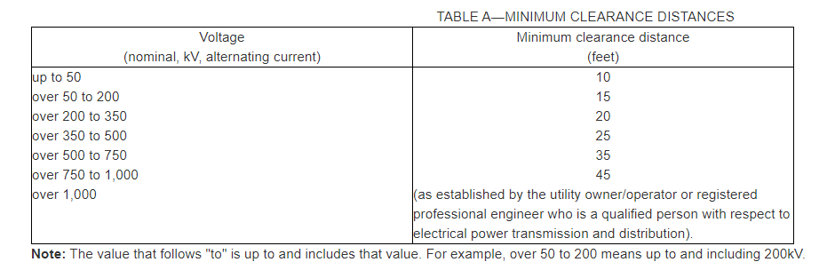
Contact with Overhead Lines
Notes:
Minimum 10’
1926.1408 Table A

Slide 6

Mitigating Exposure
Maintain Electrical components in good conditions
Using electrical components as designed
Never work on “Live” circuits
Never expose “Live” bare circuits
Use GFCI
Proper tools for the task

Slide 7

Voltage Testing
“Hot Stick”
“Live - Dead - Live”
Notes:
GFCI

Slide 8
Voltage Testing
“Multimeter”
Notes:
GFCI

Slide 9


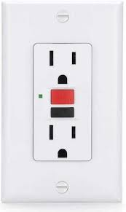
G F C I
Ground Fault Circuit Interrupter

Slide 10


Ground Fault Circuit Interrupter
1926.404 Wiring Design and Protection
All 120-volt, single-phase 15- and 20-ampere receptacle outlets on construction sites, which are not a part of the permanent wiring of the building or structure and which are in use by employees, shall have approved ground-fault circuit interrupters for personnel protection

Slide 11
Proper use of equipment
Equipment and tooling shall only be used on its approved voltage and design
        “Daisy chaining”
          Hot wiring
            “Oversizing” breakers
              Modifying cords
Notes:
GFCI’s are designed to sense an imbalance in current flow over 5mA
A surge protector protects your equipment from excessive voltage.

Slide 12
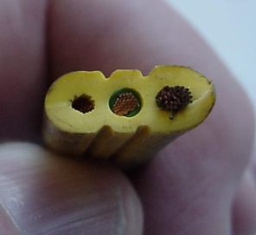
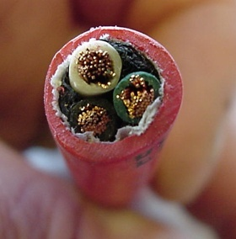
Proper Equipment
Extension cord shall be of three-wire type and shall be designed for hard or extra-hard usage
Flexible cords used with temporary and portable lights shall be designed for hard or extra-hard usage
Notes:
GFCI’s are designed to sense an imbalance in current flow over 5mA
A surge protector protects your equipment from excessive voltage.

Slide 13
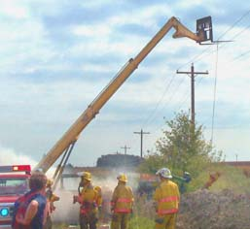
If someone gets shocked
Call 911
Don’t touch worker in contact with energized circuit-- You could get shocked too!
De-energize circuit if possible
If not, use non-conductive object to push victim away from source of current Does not apply to high voltage lines
Start CPR or other first aid.

Slide 14

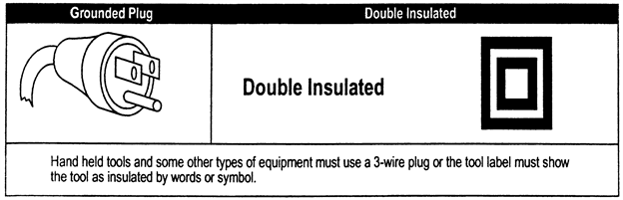
Double Insulated & Grounded Tools
1926.302(a)
“Electric power operated tools shall either be of the approved double-insulated type or grounded”

Slide 15

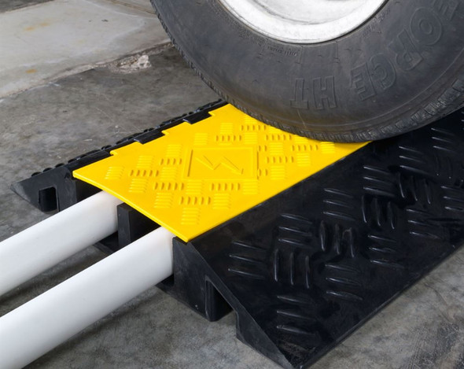
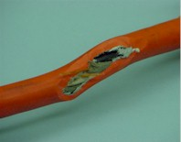
1926.416
Cords shall be kept free from walkway and work spaces
Worn frayed cords prohibited
Extension cords shall not be:
  Stapled
  Hung from nails
  Suspended by wire
Notes:
Zipties OK

Slide 16
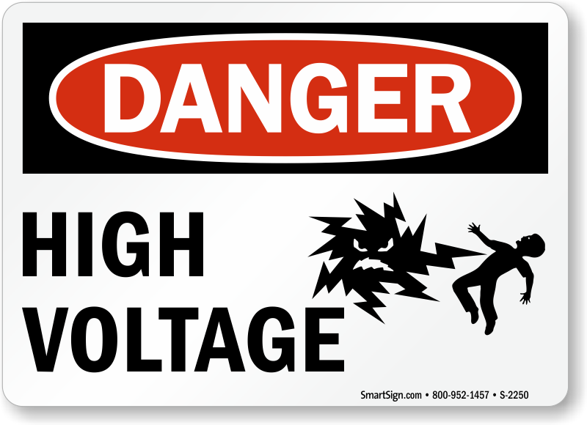
1926.404 Wiring Design & Protection
Warning signs. Signs warning of high voltage shall be posted where unauthorized employees might come in contact with live parts.
Circuit breakers must clearly indicate open or closed position
Should identify what they control

Slide 17
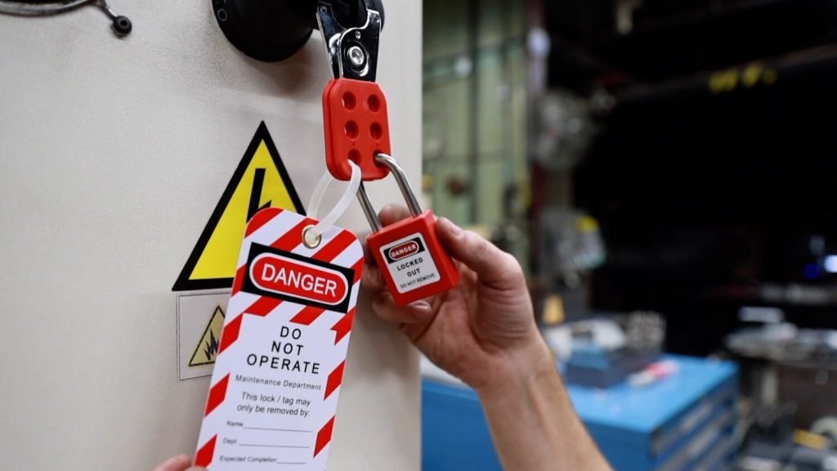
Lock Out Tag Out

Slide 18

Energy Control Procedure (Lockout)
Prepare for shutdown
Shut down equipment
Isolate all energy sources
Apply locks & tags
Release stored energy
Verify equipment isolation
Perform the task
Release from Lockout
Notes:
Inform the group:
There are 8 steps to preform a proper and safe LOTO.
We will go over each step on the following slides.
Group participation: Have members of the group read each of the following 8 slides. Emphasize the bullet points on each of the slides.

Slide 19


1/2. Prepare for shutdown & Shut down equipment
Understand equipment hazards
Notify other workers of shutdown
Use the normal shutdown procedures
Turn all switches to OFF/Neutral

Slide 20
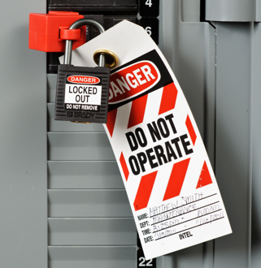
3/4. Isolate all energy sources & Apply locks/tags
Use applicable energy isolation devices
Apply locks and tags

Slide 21
5/6. Release stored energy & Verify equipment isolation
Check that other workers are clear of potential hazards
Check that locking devices are secure
Attempt normal startup
Return control to Open/Neutral

Slide 22
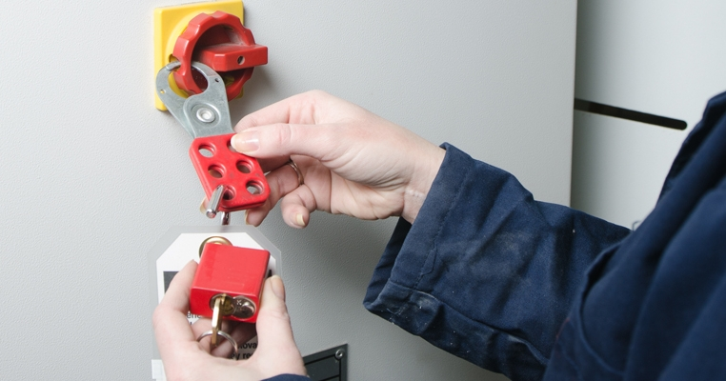
7/8. Perform the task & Release from Lockout
Ensure all tools removed
Notify and check
Remove LOTO devices
Must be removed by authorized employee who applied it

Slide 23
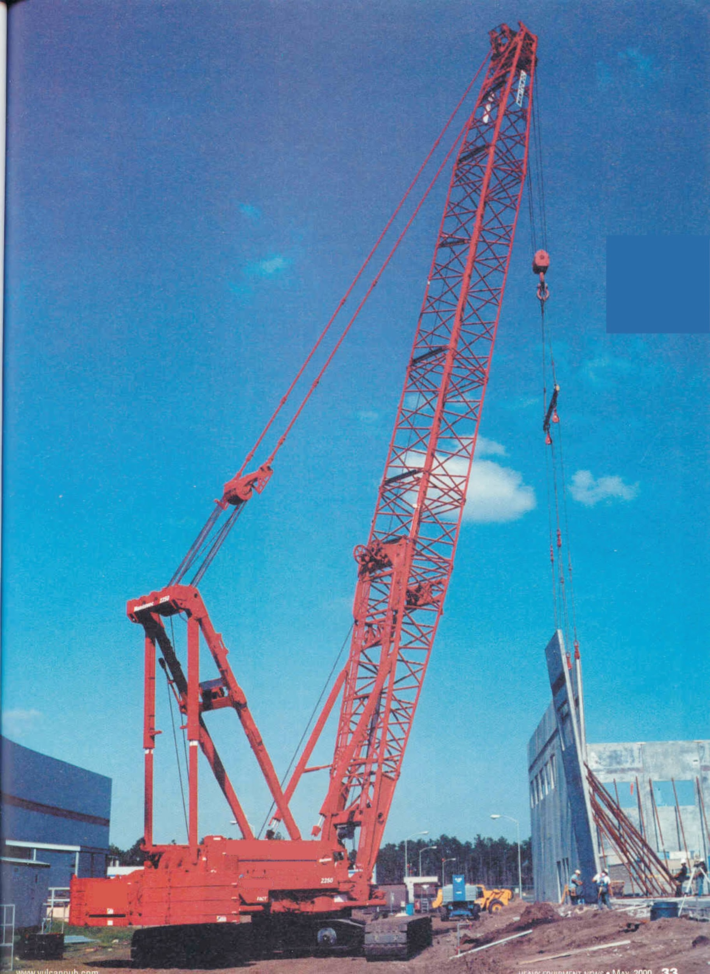
Cranes & Rigging
The area directly beneath the load that suspended materials could fall in the event of an accident.
Always identify the travel path of the suspended loads
Fall Zone

Slide 24
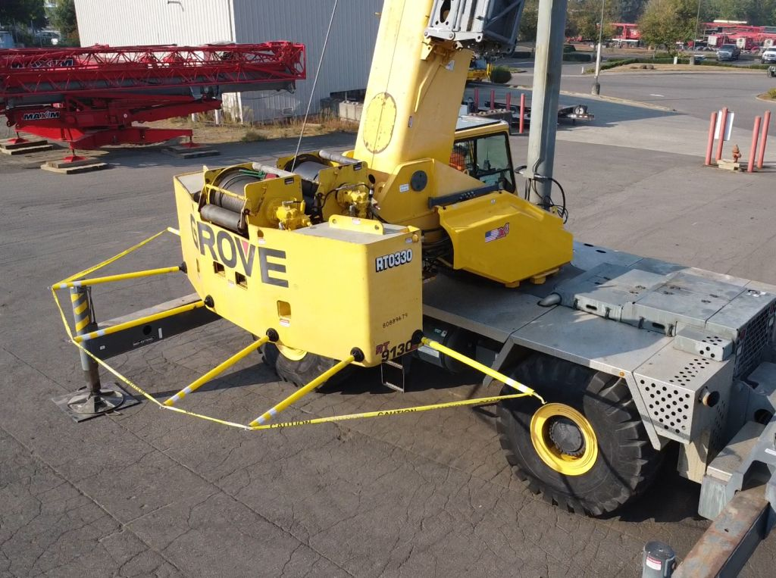
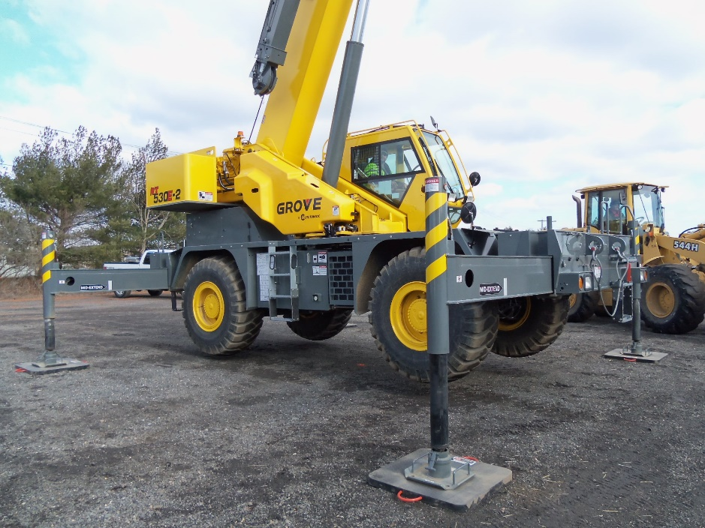

Swing Radius
All cranes shall protect from the pinch point created by the counterweight of the machine.

Slide 25

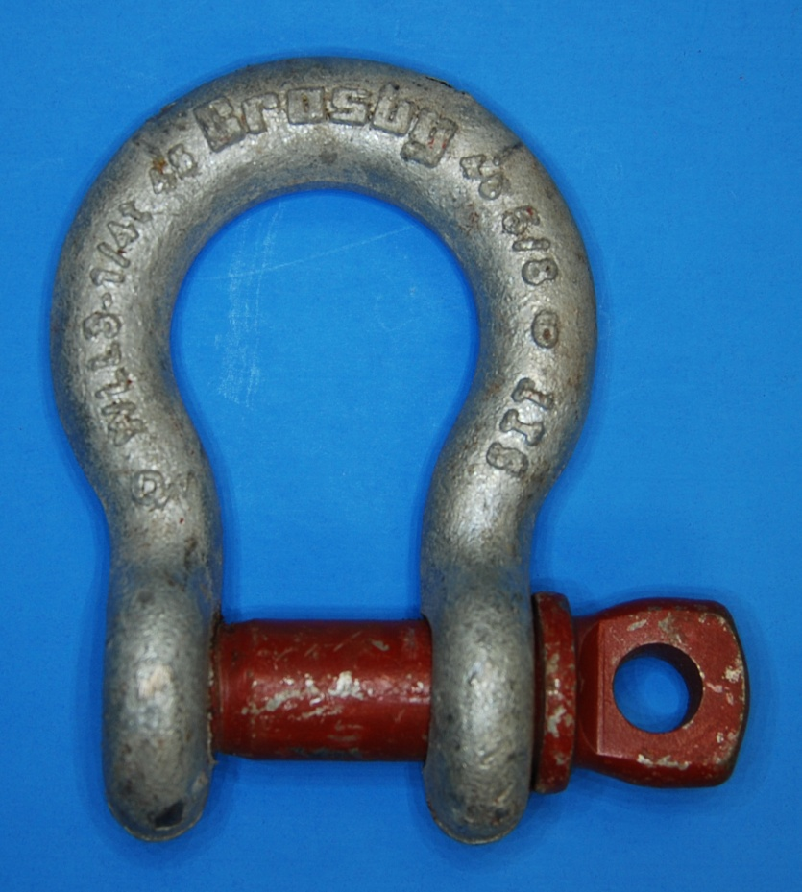
SLINGS & HARDWARE
WLL
Manufacturer
Country of Origin

Slide 26
Ladder Use: Common Hazards
Improper set-up
Portable ladders not 3 feet above landing surface
Not securing ladder correctly
Standing on the top two steps of a stepladder
Overreaching when working from a ladder

Slide 27
Select the Proper Rating

Slide 28
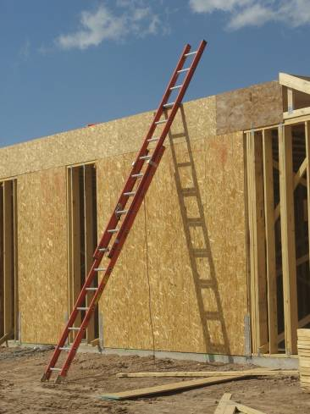
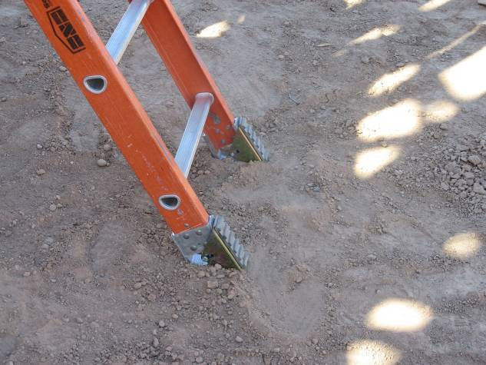
OSHA Requirements: Extension Ladders
Three feet above landing
Setup and Maintain 4:1 ratio
Stable Ground
Assist coworker

Slide 29

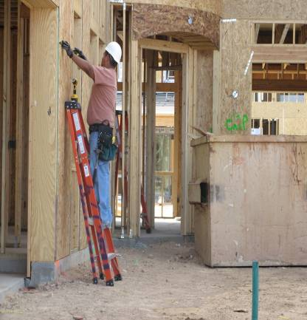
OSHA Requirements: Step Ladders (A-Frame)
Top two rungs off limits
Use and setup as-designed
Work within side rails

