Slide 1
2023 Site Safety Training

Slide 2
Safety Policy
The safety protocols in this training are mandatory and considered a minimum standard for performing safe work
All site personnel are responsible to comply with these rules and procedures as a condition of their presence onsite
All workers expected to perform assembly work for the majority of one, or multiple days must attend this safety training and pass the quiz at the end
Notes:
video

Slide 3
Authorized Site Personnel
This training is not intended for those making deliveries, visiting, judging or staging the interior of the modules
For those personnel an escort will be required during their time onsite by the Safety Team Lead or an individual holding a current OSHA 10/30 Hour card
Notes:
video

Slide 4
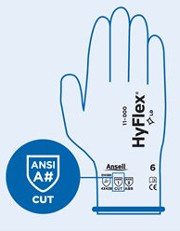
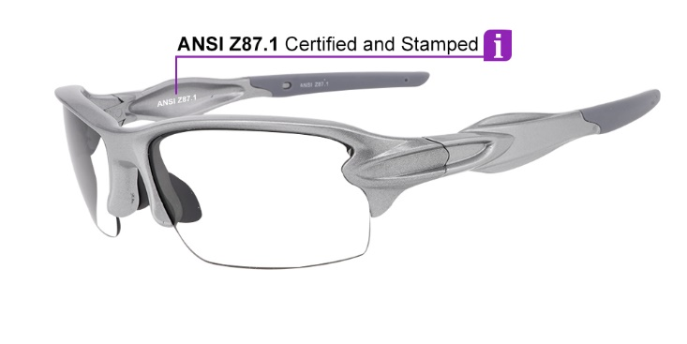
Personal Protective Equipment
During the assembly phase PPE is required at all times when outside of the designated break areas
Hard Hat
ANSI Z87 rated safety glasses
ANSI A2 cut resistant gloves
Class II reflective safety vest
Notes:
video

Slide 5
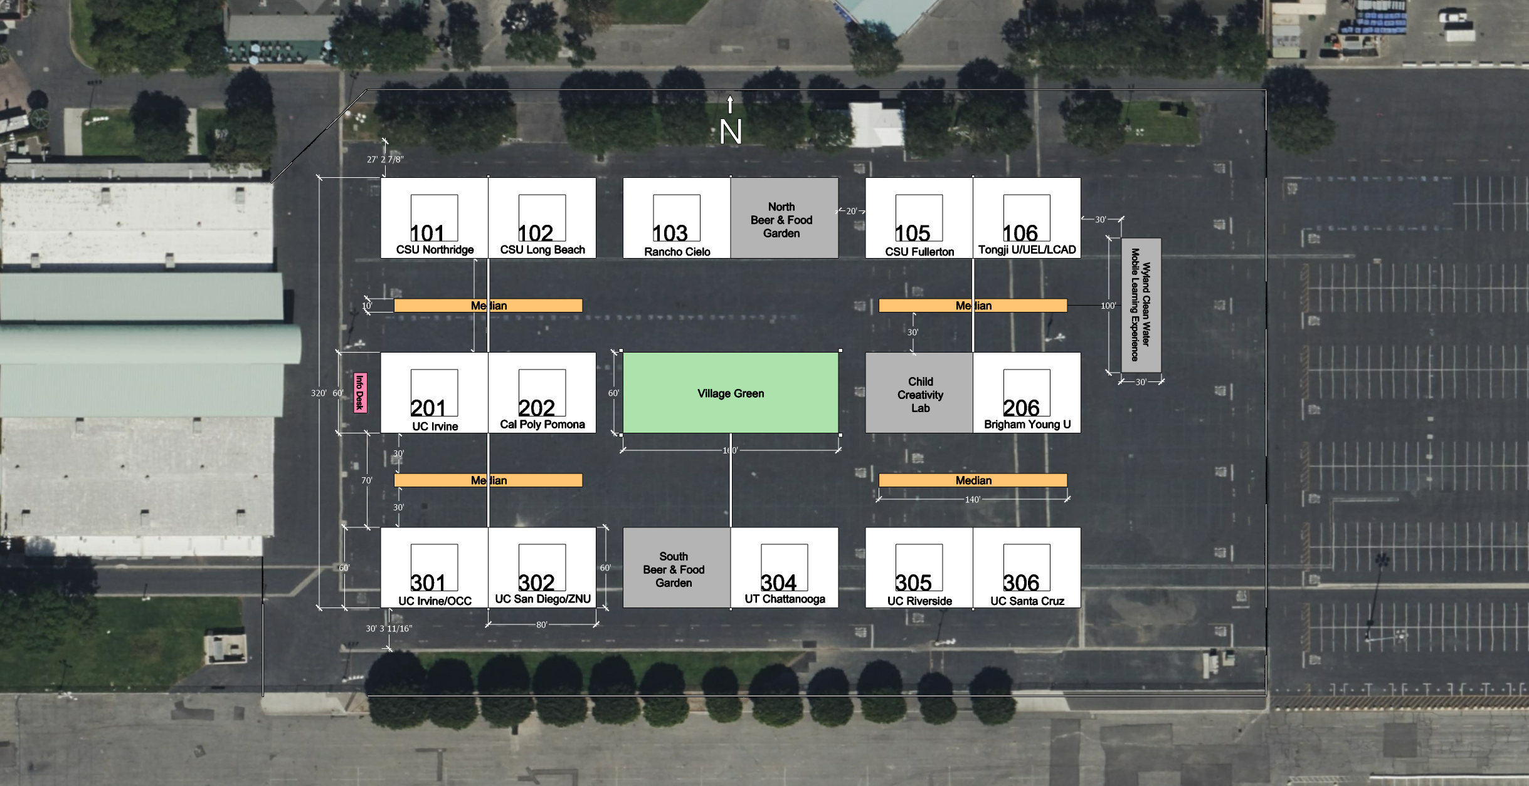
BREAK AREAS
Notes:
video

Slide 6
Team Safety Officers
Notes:
video

Slide 7
Stop Work Authority
All workers, vendors, delivery and site personnel have the authority and responsibility to stop work in the event an unsafe act is being performed
The actions triggering the Stop Work must be resolved prior to work continuing
Notes:
video

Slide 8
General Site Safety Rules
Pedestrians shall Yield to all cranes, vehicles and motorize equipment
Respect all signs, cones and barricades.
Do not cross under caution tape or manipulate travel lanes
Understand all risks associated with daily tasks prior to entering work area
Notes:
video

Slide 9
General Site Safety Rules
Identify and avoid Line of Fire potential, always have a route to safety
Wear appropriate PPE for work being performed
Do not operate equipment or vehicles unless you have been trained
Mobile phone use is strictly prohibited while operating or driving equipment
Notes:
video

Slide 10
Emergency Preparedness
Each team shall designate the following at the start of each shift:
Caller for emergency services
Runner to intercept and direct Emergency Responders to location
Someone to fetch First Aid Kit/AED
All team members shall familiarize themselves with site exits and entrances to be used in an emergency
Notes:
video

Slide 11
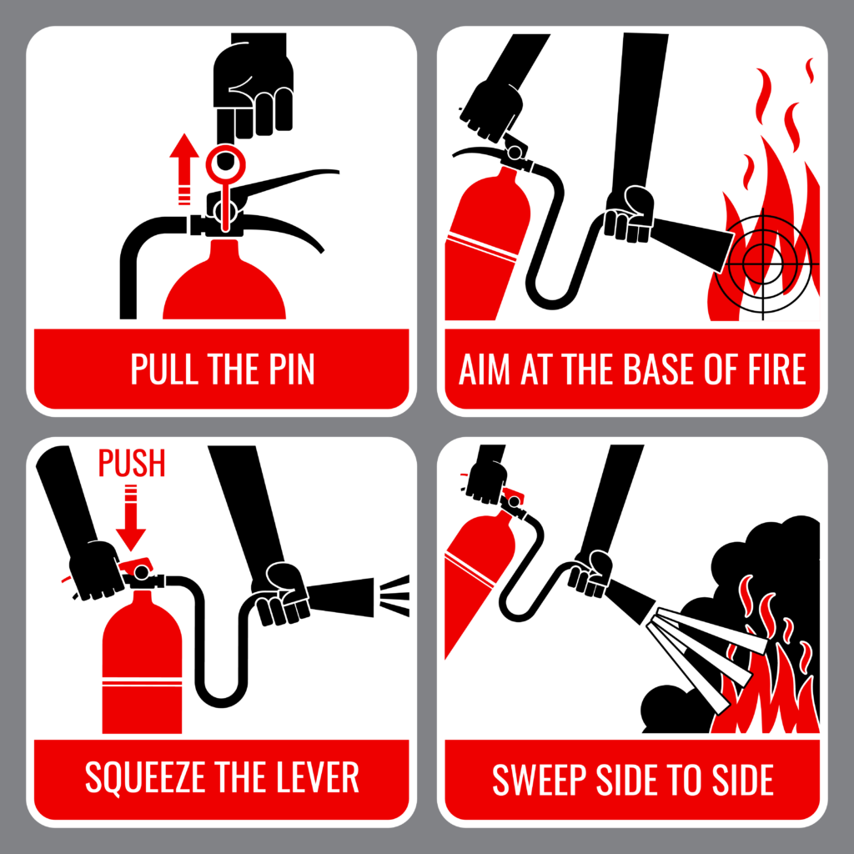
Fire Protection
Each team shall have, at minimum, a 10 Lbs. ABC rated fire extinguisher located in the work area
Remember P.A.S.S
Pull
Aim
Squeeze
Sweep
Notes:
video

Slide 12
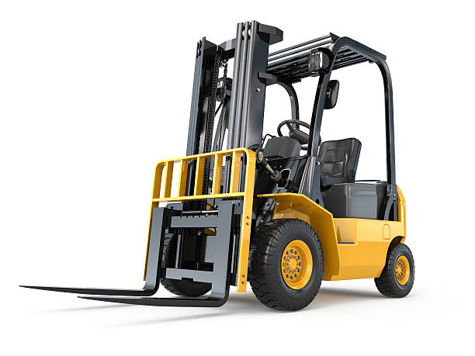
Equipment Use
California law prohibits individuals from operating Forklifts and Telescoping Handlers unless licensed by an approved trainer
Any individual operating equipment shall be trained and authorized on that piece of equipment
Notes:
video

Slide 13
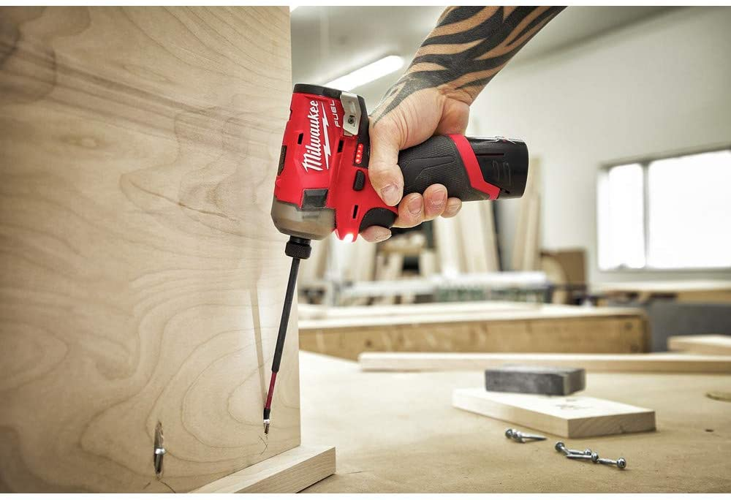
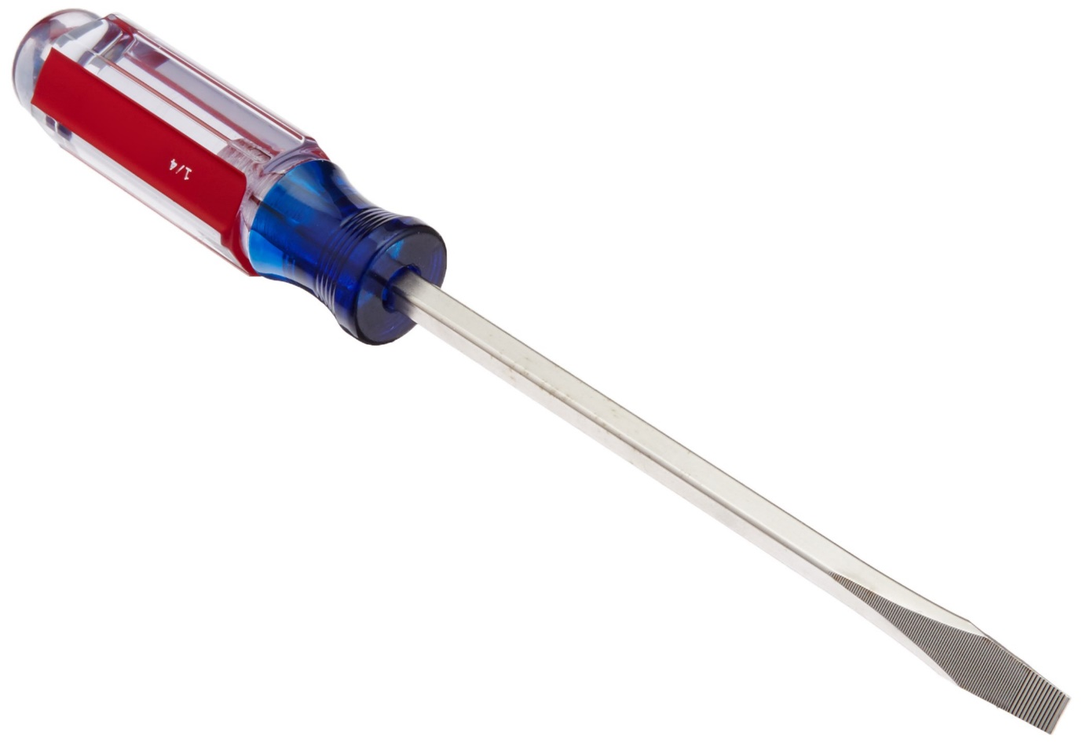
Hand and Power Tools
Understand the tool’s proper application and limitations
Inspect all tools prior to each use
Guards must be in place if provided
Do not operate a tool if
You are not comfortable with it
The level of instruction you received is inadequate
PPE
Notes:
video

Slide 14
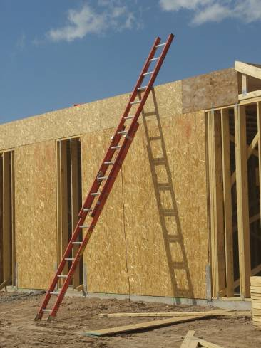
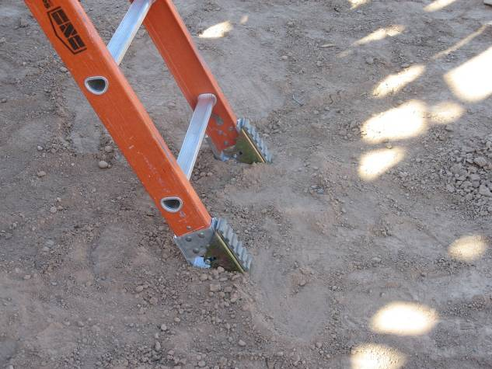
Ladder Use
Three feet above landing
Setup and Maintain 4:1 ratio
Stable Ground
Assist coworker

Slide 15
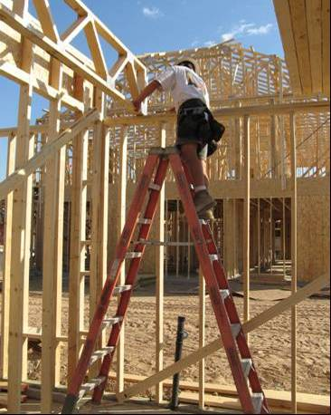
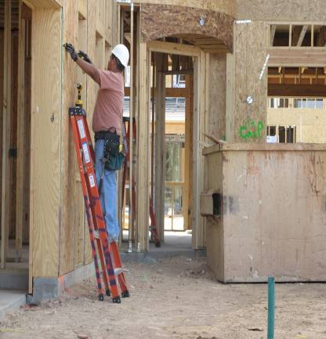
Ladder Use
Top two rungs off limits
Use and setup as-designed
Work within side rails

Slide 16
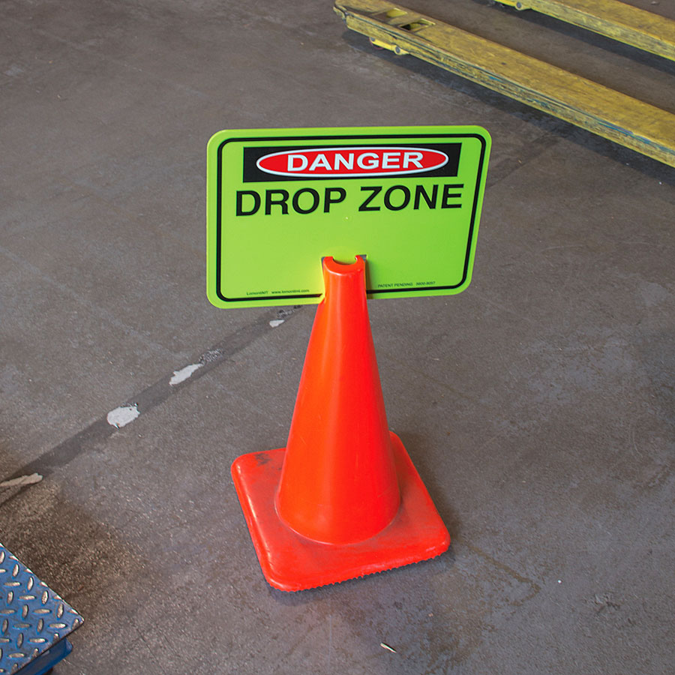
Drop Zones
Any time an employee is working above the work area, a ‘Drop Zone’ must be established
Large enough to accommodate falling objects
Cones/caution tape
Personnel controlling access
Ask permission to enter the drop zone
Never toss materials or tools to employee working overhead.
Notes:
video

Slide 17
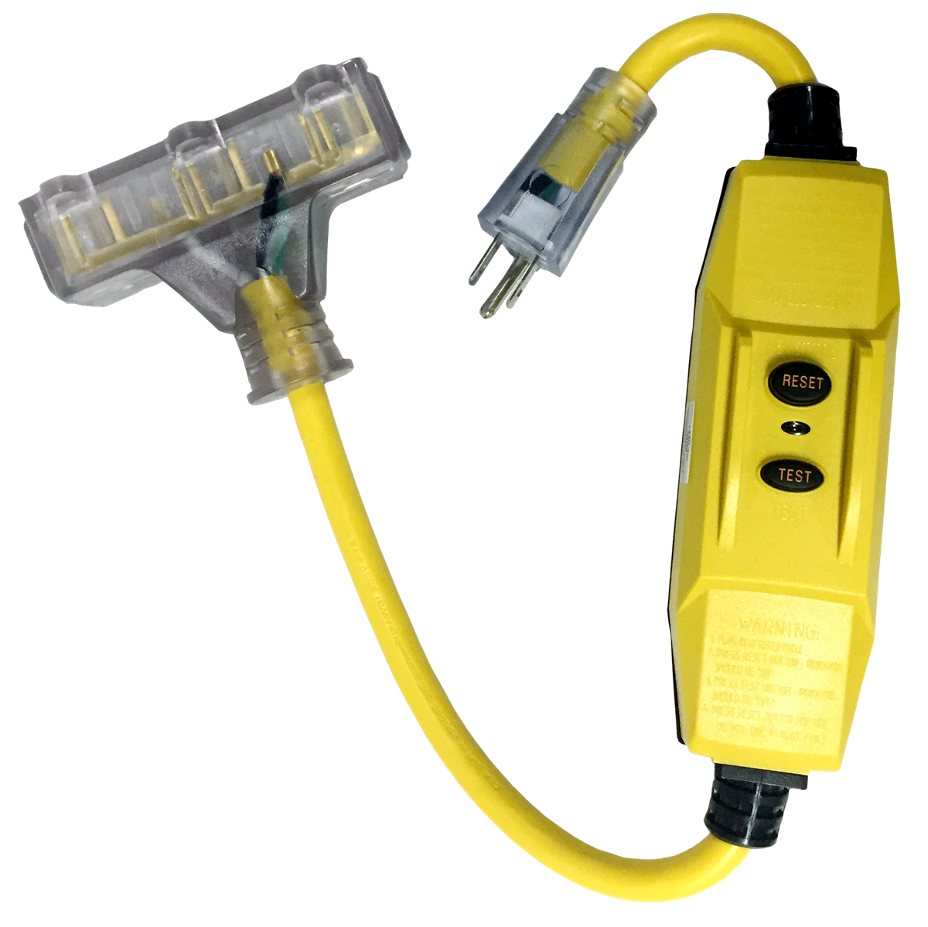
Electrical
A GFCI must be used on all temporary power systems
Test GFCI prior to use
Protect all extension cords from damage
Do not repair extensions cords unless trained to do so
Only use certified electrical tools and components rated for task
It is prohibited to work on electrical components unless your safety team lead has verified the absence of voltage
Notes:
video

Slide 18
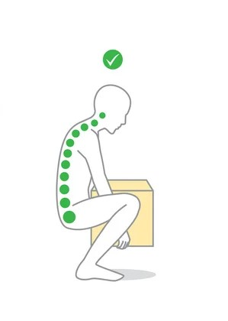
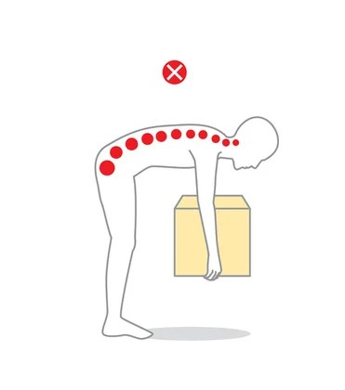
Manual Material Handling
Strains and Sprains account for a large portion of the injuries on construction sites
Size up the load prior to lifting
Ask for assistance if over 50 Lbs.
Keep load as close to body as feasible
Lift with a straight back and use the legs
If the load is too heavy for two use mechanical assistance
Notes:
video

Slide 19
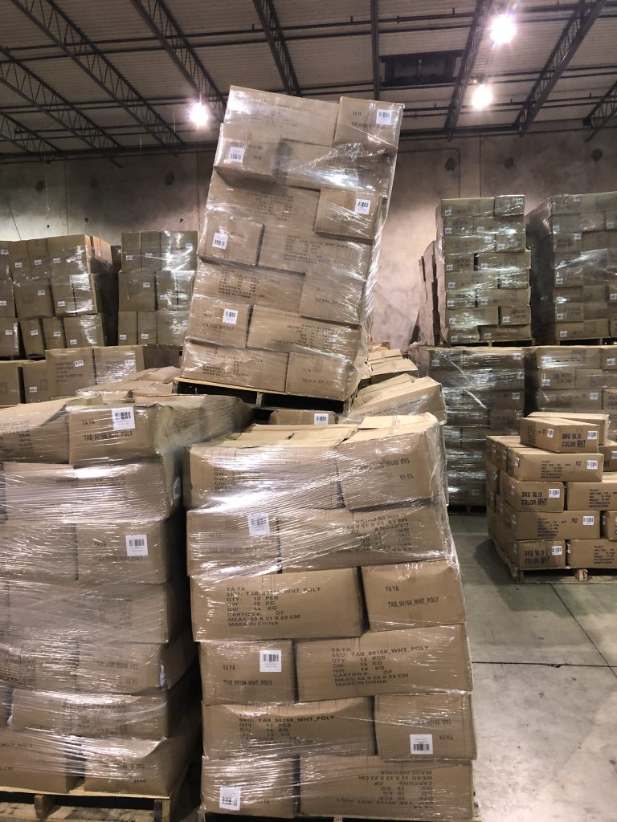
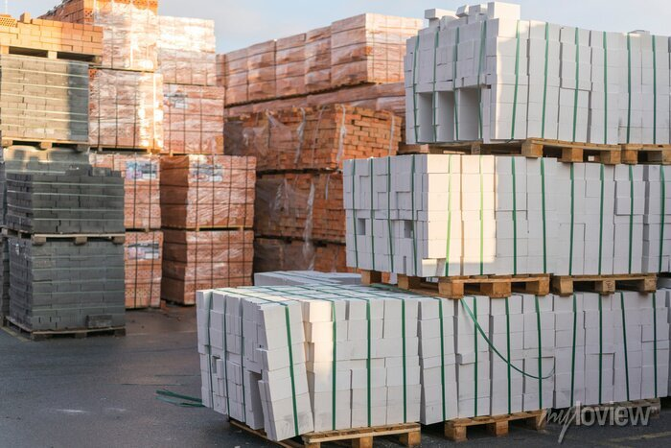
Material Storage
Always store materials wider at the bottom and more narrow at the top
Avoid creating stored energy for your coworkers
Perform housekeeping regularly to maintain a work site free of trip hazards
Notes:
video

Slide 20
Heat Illness Prevention
California Law requires all construction sites to comply with state regulations for the prevention of Heat Illness.
The following slides contain required work practices for compliance
Notes:
video

Slide 21
Heat Illness Prevention
All OCSD teams are responsible to provide the following:
Access to water
Access to shade
Weather monitoring
Emergency response
Notes:
video

Slide 22
Access to Water
Potable drinking water must be made available at no cost to all workers
Maintain at all times, sufficient quantities of pure and cool potable drinking water
Adequate quantity is defined as one quart per employee per hour
Notes:
video

Slide 23
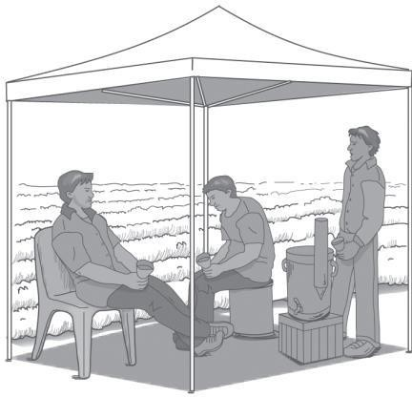
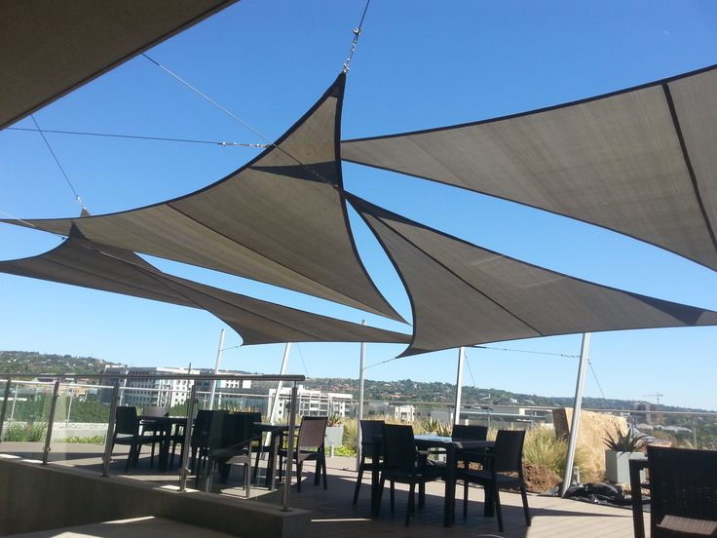
Temperatures in excess of 80°F
Shade shall be provided when temperatures reach an excess of 80°F
Locate shade as close as practical to work area
Shade must be large enough
to accommodate all employees
on rest/recovery
Access to shade must be
permitted at all times
Notes:
video

Slide 24
Temperatures in excess of 95°F
The following measures be implemented:
Designate individual to observe employees for symptoms of heat illness
Mandatory buddy system
Designate individual to call emergency services in event of heat illness incident
Review prevention measures prior to start of shift
Notes:
video

Slide 25
Temperatures in excess of 95°F
Employees must take a MINIMUM 10-minutes, uninterrupted, rest every two hours
Additional break must be provided at the end of the 8th and 10th hour of work
Notes:
video

Slide 26
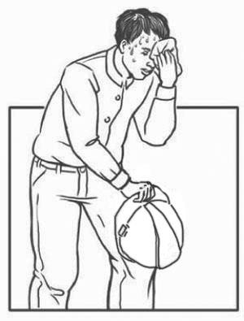
Personal Risk Factors for Heat Illness
Age
Level of acclimatization
Overall Health
Alcohol and caffeine consumption
Prescription medications
Antihistamines
Diuretics
Some psychiatric or
Blood pressure medicines
Use of illicit drugs (opioids, methamphetamines or cocaine)
Notes:
video

Slide 27
Preventative Measures
Hydrate prior to start of work
Drink frequent, small amounts of water
Avoid drinking water that is too cold
Avoid heavily caffeinated beverages
Sports drinks with electrolytes in times of heavy sweating
Notes:
video

Slide 28
Notes:
video

Slide 30
Scan QR code now for Quiz

